Slide 1
What’s In It For You
The Beekeepers of Indiana
May 13, 2018

Slide 2

Different Organizational Levels
Local Clubs
State Associations
Regional Societies
National Federation
International

Slide 3
Local Clubs
Monthly Meetings
May Have Less Structure
No/Minimal/Donation Dues
One/Several Counties
Mentor Programs
Hands On Clinics
  Candy Boards
  Woodworking Build Days
  Field Days
What do you get back?

Slide 4
The Beekeepers of Indiana
Quarterly Board Meetings
Officers/Board of Directors
Set Dues
Renowned Guest Speakers
Bee School
State Fair Participation
Queen Breeding Program
Young Beekeeper Award Program
Indiana Honey Queen Program
Jump Starter Program
Quarterly Newsletters
Swarm/Cut Out Lists
Local Honey Lists
What do you get back?

Slide 5
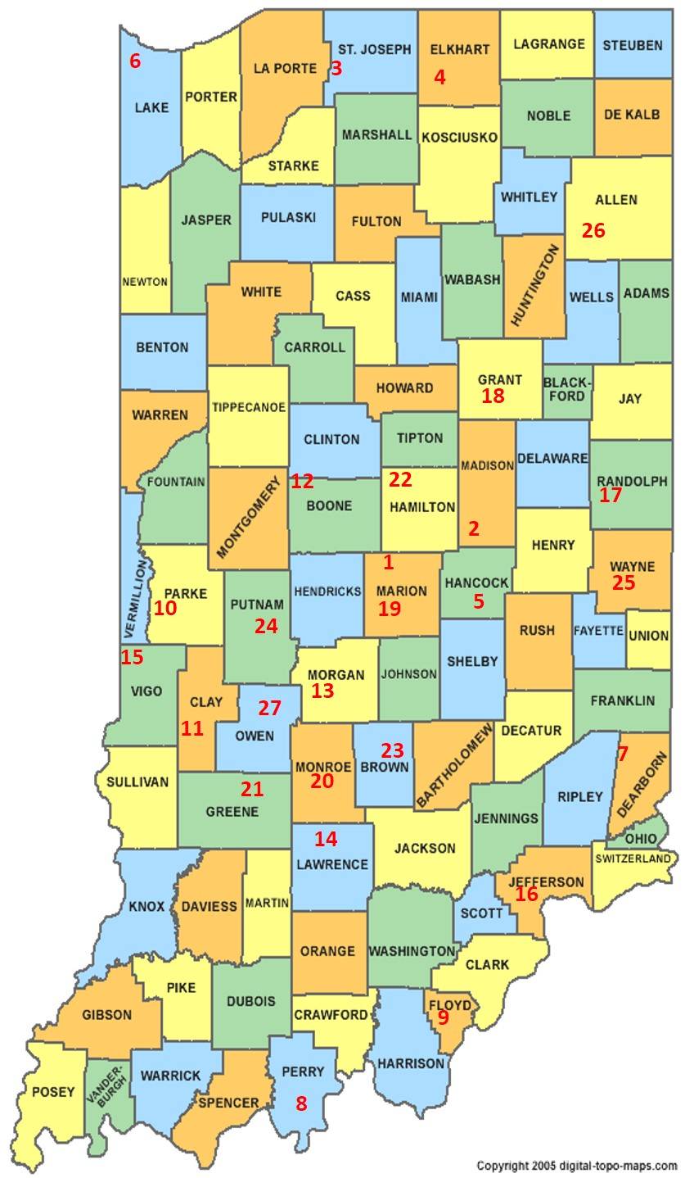
30 Established Clubs
Access to Jump Starter Program
Access to Speakers
Articles in the Newsletter
Advertising on website
Club Website
New Member Information
Right to take a day at State Fair
Daily Tickets for Volunteers
Make money for the club

Slide 6
Regional Societies
Heartland Apicultural Society
Eastern Apicultural Society
HAS Yearly Conferences
  St. Louis, MO
    July 11-13, 2018
    www.heartlandbees.org
EAS Yearly Conference
  Virginia, Hampton Roads Convention Ctr
    Aug 13-17, 2018
    http://www.easternapiculture.org/
  Grants/Sponsor Researchers
What do you get back?

Slide 7
National Federation
American Beekeeping Federation
Yearly Meeting
  Galveston, Texas
  Officers/Board of Directors/Delegates
Dues Based on Hives
Lobbyist, Legal Campaigns
Bee Labs/ Scientific Community
Newbie Program
Webinars
Newsletters
What do you get back?

Slide 8
Contact Information
The Beekeepers of Indiana
Debbie Seib, Treasurer
beekeepers.indiana@yahoo.com
Heartland Apicultural Society
Debbie Seib, Treasurer
heartland.apicultural@yahoo.com
American Beekeeping Federation
Debbie Seib, Board of Directors
debbie@seibshoosierhoney.com
Phone: 317.432.9578

Slide 9
Questions?

