Slide 1
Beginning Beekeeping

Slide 2
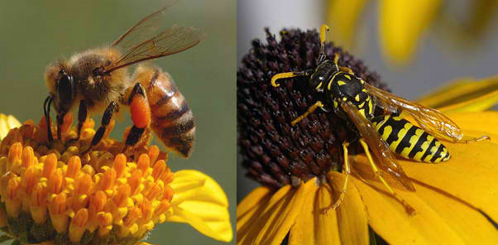
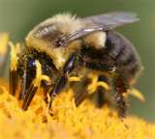
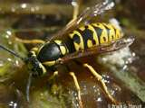
Which One is the Honey Bee?
A
B
Honey Bee
Yellow Jacket
C
D
Bumble Bee
Hornet
The Answer is: A

Slide 3

Why Would You Become a Beekeeper?
Pollination
  “One-third of our total diet is dependent, directly or indirectly, upon insect-pollinated plants.“
Honey
Beeswax
Meet Great People
Love of the Bees
Make Money
XXX
Notes:
**One-third data comes from a McGregor 1976 USDA publication.

Slide 4
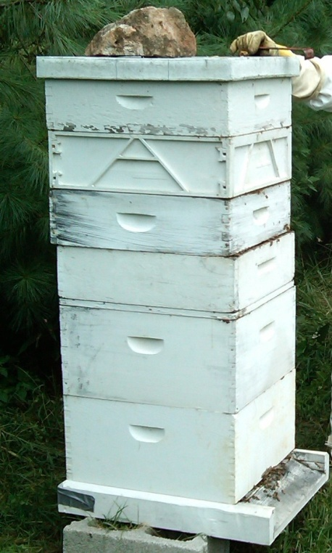
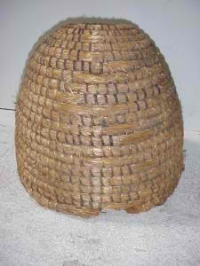
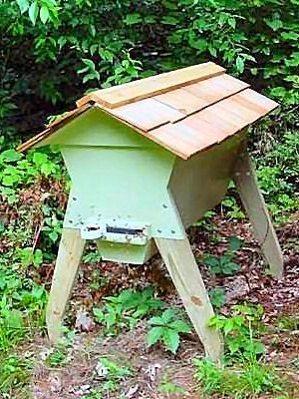
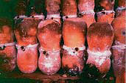
History
20,000 species of bees in the world.
Honey Bees are not indigenous to North America.
Clay Pots
Top Bar Hive
Skep
Langstroth 1851
Notes:
4,000 are found in American north of Mexico
1683 immigrants brought Bees here.
Reverend Lorenzo Langstroth.

Slide 5
Other Things to Consider
Natural or Treat
Source of Bees
Land
  Own, rent or find free locations
Building
  Where to store and repair equipment
  Mix bee food and treatments
  Extract and handle honey
Vehicle
  Haul equipment
  Haul products to markets

Slide 6
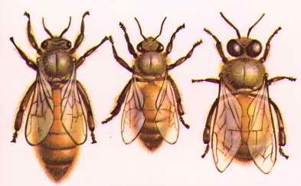
Types of Bees in the Hive

Slide 7
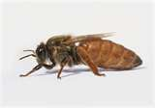
Queens
Is the longest of the three types.
Lives about 2-3 years.
Is the only bee that can lay fertile eggs.
She can lay up to 2,500 eggs per day.
Requeen unproductive queens

Slide 8
Queens
Is the longest of the three types.
Lives about 2-3 years.
Is the only bee that can lay fertile eggs.
She can lay up to 2,500 eggs per day.
Requeen unproductive queens

Slide 9
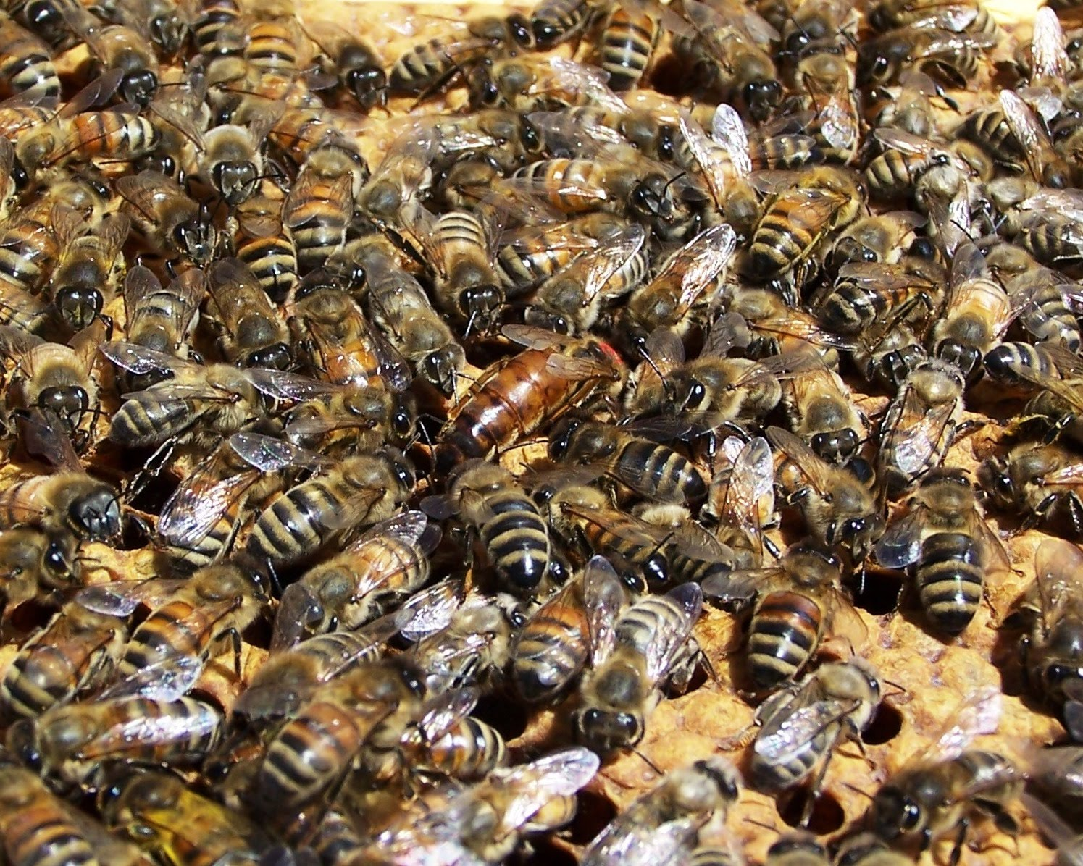

Slide 10
Queen Coloring
Standard Color Chart
  Years Ending in 1 or 6 – White
  Years Ending in 2 or 7 – Yellow
  Years Ending in 3 or 8 – Red
  Years Ending in 4 or 9 – Green
  Years Ending in 5 or 0 - Blue

Slide 11
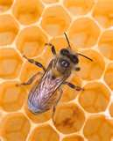
Worker Bees
Are female.
Live 6 to 8 weeks – Summer
Live 3 mos - Winter
Have many jobs in the hive
  House bees (3 weeks)
  Guard bees
  Field bees
  Scout bees
Notes:
House bees feed the young, feed the older larvae, feed the queen, clean the hive, do all the building, and store the pollen.
Guard bees protect the hive from intruders.
Field bees forage for nectar, pollen, propolis, and water.

Slide 12
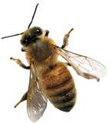
Drones
Are Male.
They have no stinger.
Their only job is to mate with the Queen.
They are kicked out of the hive in the fall.

Slide 13
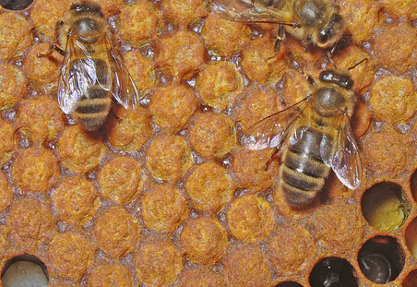
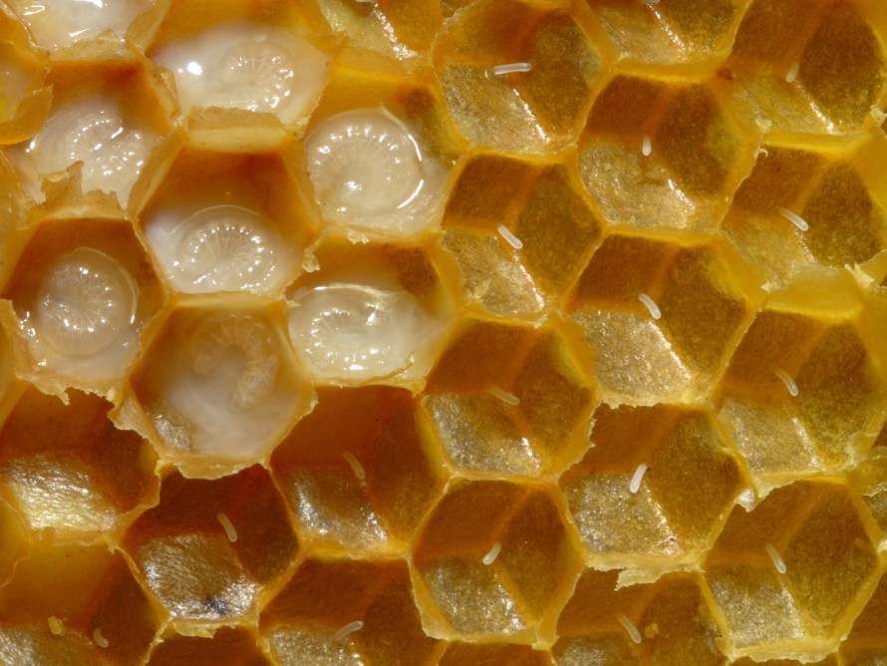
Life Cycle of Honey bees
Type | Egg | Larva | Cell Capped | Pupa | Average Day until emergence
Queen | up to day 3 | up to day 8 1/2 | day 7 1/2 | day 8 until emergence | 16 days
Worker | up to day 3 | up to day 9 | day 9 | day 10 until emergence | 21 days
Drone | up to day 3 | up to day 9 1/2 | day 10 | day 10 until emergence | 24 days

Slide 14
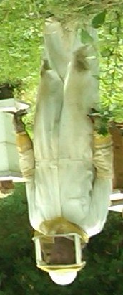
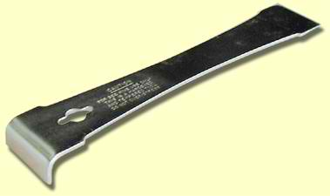
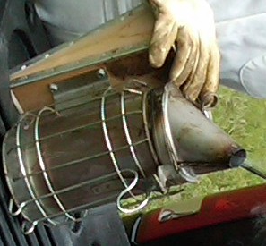
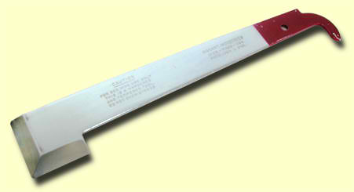

Tools of a Beekeeper
Bee Suit
Smoker
Hive Tools
Bee Brush
Notes:
Even if you don't buy any other equipment, get a smoker. It is the most important item of beekeeping equipment you can own. You may be able to do without all the other basic equipment, although that is not recommended, but a good smoker is absolutely necessary.
This red tool, called a Frame Lifter & Scraper, is much easier to use for many functions, as it makes it simple to pry up the edges of the frame top bars when removing them, and its beveled edge is great for prying and scraping. However, the Steel Hive Tool excels at cleaning the bottom board when you are reaching in from the top, it's great for removing nails, and it even doubles as a hammer.

Slide 15
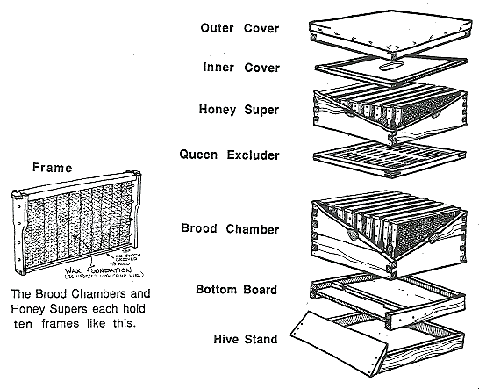
Parts of a Hive
Bottom Board
Entrance Reducer
Brood Boxes
  Frames
  Foundation
Queen Excluder
Inner Cover
Outer Cover
Honey Supers
  Frames
  Foundation
Notes:
An outer cover, which is, simply put, a lid.
An inner cover, that acts as a spacer between the outer cover and the main part of the hive.
Honey supers, which are boxes that each have 10 "frames" that bees will put nectar, and later honey on.
A queen excluder, which keeps the queen bee in the lower part of the hive.
The brood box(es), which is the part of the hive that the queen lives in, and where she lays her eggs, also known as brood.
The bottom board, that is a base that the other parts rest on.

Slide 16
Putting Your Hive Together
Use Screws Instead of Nails
Paint or Eco Wood
  High Quality Outdoor Paint
  Two Coats
  Top Edges are Critical
Ten Frames in Brood Boxes
Nine Frames in Honey Supers

Slide 17
Location of Your Hive
Plenty of Sun
Facing the East/South East
Wind Break
Eight Inches Off the Ground
Other Animal Prevention
Easily Accessible

Slide 18
How to Get Bees?
Gift
Packages
Nucs
Swarms
Splits
Cutouts

Slide 19
Packages
3lbs of bees
Queen in a Cage
  Not Bees Mother
Usually From GA or CA
Low Survival Rate
  Stress
  Weather

Slide 20

Nucs
No Standard Definition
Four/Five Frames
Cardboard Box
Laying Queen
Four Drawn Out
  Three Frames of Brood
Notes:
**One-third data comes from a McGregor 1976 USDA publication.

Slide 21
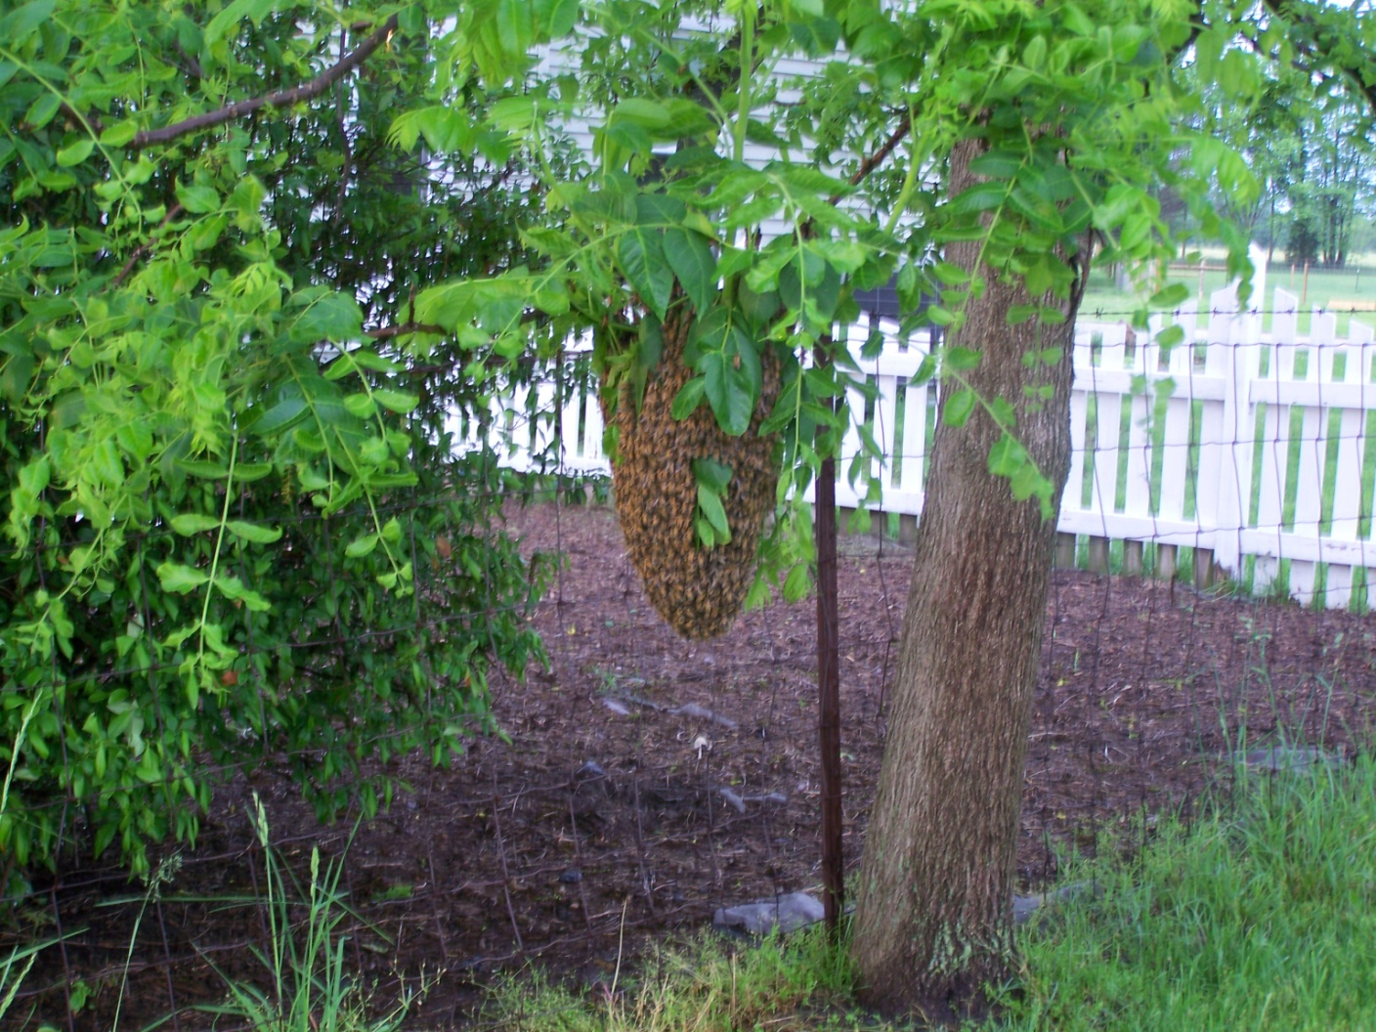
Swarms
Return
Notes:
**One-third data comes from a McGregor 1976 USDA publication.

Slide 22
Swarms
Natural Split from a Hive
Old Queen
½ the Bees
Land Temporarily
Swarm Traps
  Cardboard Box
  Lemongrass
  Old Comb
  Bee Vacs

Slide 23
Next Steps
Get Your Bees in Your Hive
Let Them Sit For 2-3 Hours
If Necessary, Release the Queen
Feed Them
  Boardman Front Feeders
  Inside Top Feeders
  Open Feeding
Inspect Your Hive Bi-Monthly

Slide 24
Now What
Attend Local Club Meetings
Get a Mentor
No/Minimal/Donation Dues
One/Several Counties
Hands On Clinics
  Candy Boards
  Woodworking Build Days
  Field Days

Slide 25
Additional Terms for a Beekeeper
Foundation - wax or plastic; sheet used by beekeepers on frames to get the bees started.
Drawn Out Comb – foundation that has been built out with wax into cells by the bees. It is ready for either honey or pollen storage or brood laying.
Packages – usually three pounds of bees and a queen in a cage
Nuc – Starter Hive
Swarm – bees that have split from another hive. Usually include a queen.

Slide 26
Additional Information
Mike Seib
  317-432-5342
  mike@seibshoosierhoney.com
Debbie Seib
  317-432-9578
  debbie@seibshoosierhoney.com

