Slide 1
Our Great State Association
The Beekeepers of Indiana
May 13, 2018

Slide 2

Different Organizational Levels
Local Clubs
State Associations
Regional Societies
National Federation
International

Slide 3
What is TBoI?
The Beekeepers of Indiana
Over 1800 Beekeepers Strong
Members in 13 States
Sponsor Four Major Events a Year
  Indiana Bee School XVII
  Purdue Field Day
  Indiana State Fair
  Fall Conference and Workshops
Belong to Regional and National Associations

Slide 4
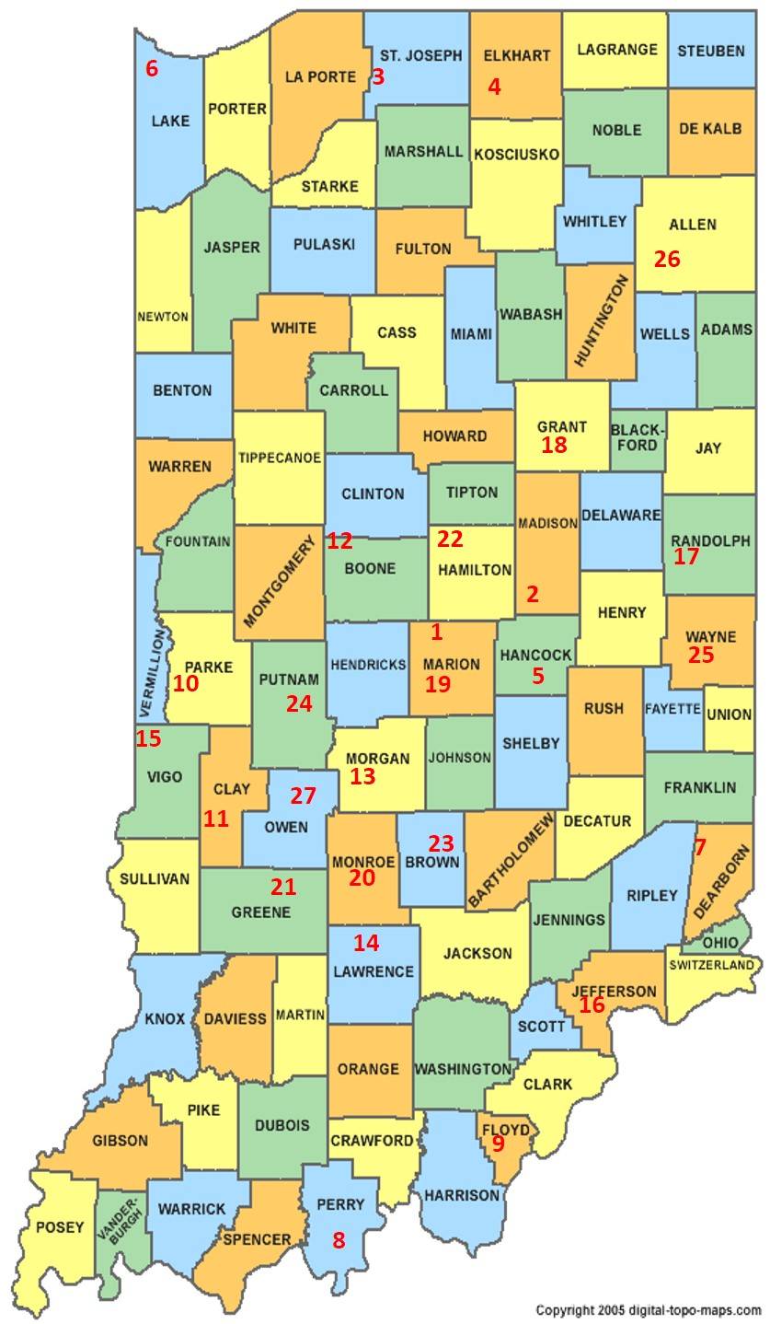
32 Established Clubs
Access to Jump Starter Program
Access to Speakers
Articles in the Newsletter
Advertising on website
Club Website
New Member Information
Right to take a day at State Fair
Daily Tickets for Volunteers
Make money for the club

Slide 5
The Beekeepers of Indiana
Quarterly Board Meetings
  Indianapolis International Airport
    7800 Col H Weir Cook Mem Dr
    Indianapolis, IN 46241
Officers/Board of Directors
Set Dues
Bee School
  Renowned Guest Speakers
State Fair Participation
Queen Breeding Program

Slide 6
Regional Directors
Jim Berndt, East Central, 311 N Union St, Westfield, IN 46074, 317-603-9875﻿, jim7310@gmail.com
Anthony Gaudin, South East﻿, 8137 Old Haggard Road﻿, Morgantown, IN 46160 765-318-0525﻿, gaudin.anthony@yahoo.com
Dan Heilman, West Central, 304 E 2nd St﻿, Michigantown, IN 46057, 765-414-5785﻿ dheilman05@yahoo.com﻿﻿
Alan Hopper, North West, 13394 Georgia St, Crown Point, IN 46307﻿, 219-712-3268﻿, alanhopper55@gmail.com
﻿﻿Curtis McBride, South West, 162 Younger Road, Bedford, IN 47421, 812-797-4269﻿, curtismcbride@hotmail.com
Tony Rekeweg, North East, 7976 N 250 W﻿, Decatur, IN 46733, 260-728-2613, rekeweghoney@gmail.com﻿﻿﻿﻿﻿﻿
At-Large Directors
Kristy Dooley, 6309 E Cascade Rd, Rockville, IN 47872﻿, ﻿812-201-6836, clctrolley@1791.com
﻿﻿Robert Duffy, 2762 E CR 100 N﻿, Danville, IN 46122﻿, 317-726-6122﻿, beekeeperin@aol.com﻿﻿
Joe Kimmel, 723 N Co Rd 500 E﻿, Paoli, IN 47454﻿, 812-653-0489﻿, jkimmel@southernhills.org
Mike Seib, 7784 N. Sanctuary Lane, Mooresville, IN 46158, 317-432-5342, mike@seibshoosierhoney.com
﻿﻿Jeanette Wiles, 16015 Union Chapel Rd, ﻿Noblesville, IN 46060, 317-697-5926﻿, jettinindy@sbcglobal.net

Slide 7
The Beekeepers of Indiana
Young Beekeeper Award Program
Indiana Honey Queen Program
Jump Starter Program
Quarterly Newsletters
  Local Club Articles
Swarm/Cut Out Lists
Local Honey Lists
New Initiatives
  License Plate Initiative
  $1,500 Tax Free Purchase
  $1,500 Income Exempt

Slide 8
Contact Information
Debbie Seib
The Beekeepers of Indiana – beekeepers.indiana@yahoo.com
Heartland Apicultural Society
heartland.apicultural@yahoo.com
Phone: 317.432.9578

Slide 9
Questions?

