Slide 1
Challenges Our Bees Face
Mike and Debbie Seib
Seib’s Hoosier Honey
February 28, 2019

Slide 2

Our Struggling Bees
Diseases
Pests
Bad Queens
Stress
Beekeeper Habits
Pesticides

Slide 3
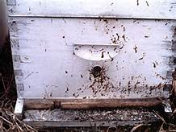
Diseases
Nosema
  Treatment: Increase ventilation
  Treatment: Fumagilin-B
Bacteria
  American Foul Brood
    Larvae < 3 days
    100 million spores
  European Foul Brood
    oxytetracycline hydrochloride
    Requeen

Slide 4
European vs American
Appearance of brood comb | Age of dead brood | Color of dead brood | Consistency of dead brood | Odor of dead brood | Scale characteristics | Infectious agent
Unsealed brood, some sealed brood in advanced cases with discolored, sunken or punctured cappings | Usually young unsealed larvae, occasionally older sealed larvae, typically in coiled stage | Dull white, becoming yellowish white to brown, dark brown, or almost black | Watery, rarely sticky or ropy, granular | Slightly to penetrating sour | Usually twisted in cell, does not adhere to cell wall, rubbery, black in color | European foulbrood
Sealed brood, discolored, sunken, or punctured cappings | Usually older sealed larvae or young pupae lying lengthwise in cells | Dull white, becoming light brown, coffee brown to dark brown, or almost black | Soft, becoming sticky to ropy | Slightly to pronounced putrid odor | Lies uniformly flat on lower side of cell, adheres tightly to cell wall, fine, thread-like tongue of dead may be present, head lies flat, black in color | American foulbrood

Slide 5
Law to Aquire Medicine
January 2017, beekeepers need a prescription from a veterinarian for antibiotics. Rule #213
Most Widely Used
  Oxytetracycline (Terramycin®)
  Tylosin (Tylan®)
  Lincomycin (Lincomix®)

Slide 6
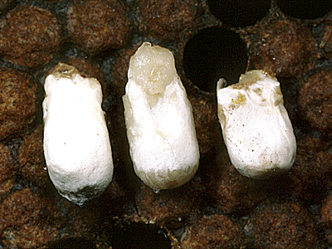
Diseases
Fungal
  Chalkbrood
    Infests gut
    Wet springs
    Increase ventilation
  Stonebrood
    Ring around the larvae head
    Strength of colony

Slide 7
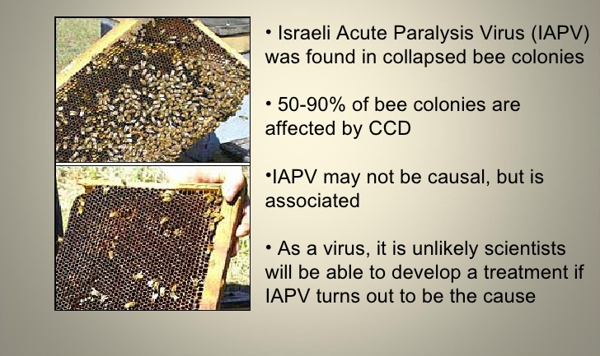
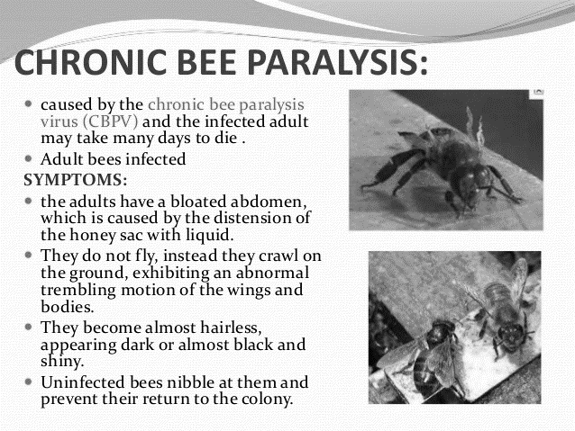
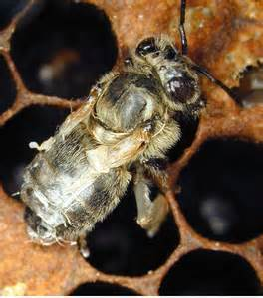
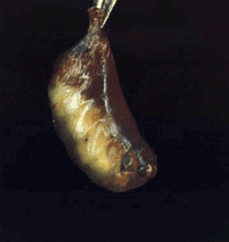
Diseases
Viral
  Deformed Wing
  Bee Paralysis
    Acute
    Chronic
  Sacbrood

Slide 8
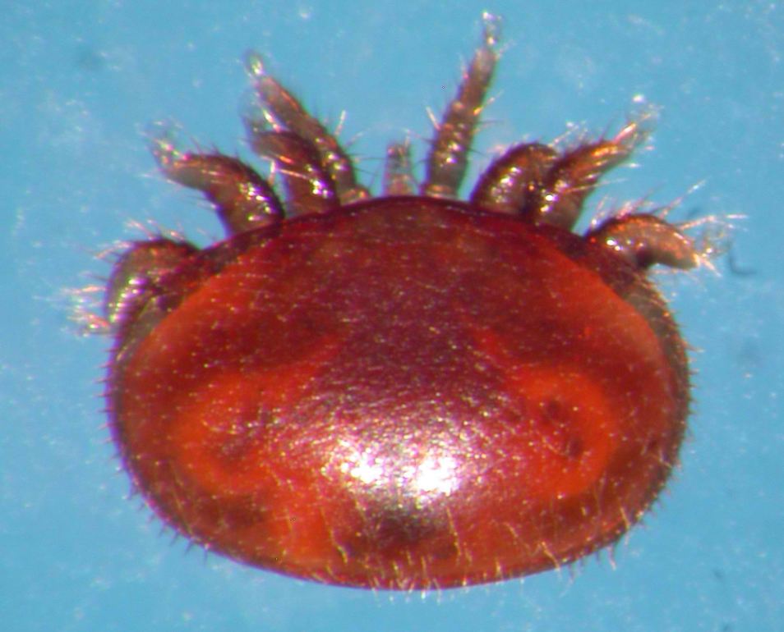
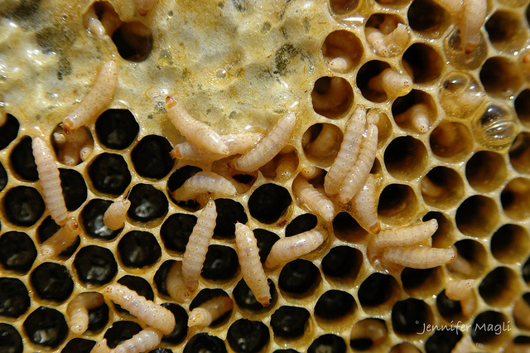
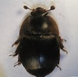
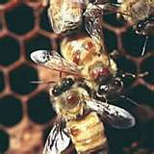
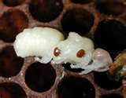
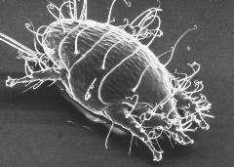
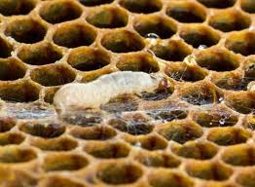
Pests
Varroa Mites
  Api-Var
  Formic Acid
Tracheal Mites
  Buckfast Bees
  Menthol (grease patties)
Small Hive Beetles
  Traps
Wax Moths

Slide 9
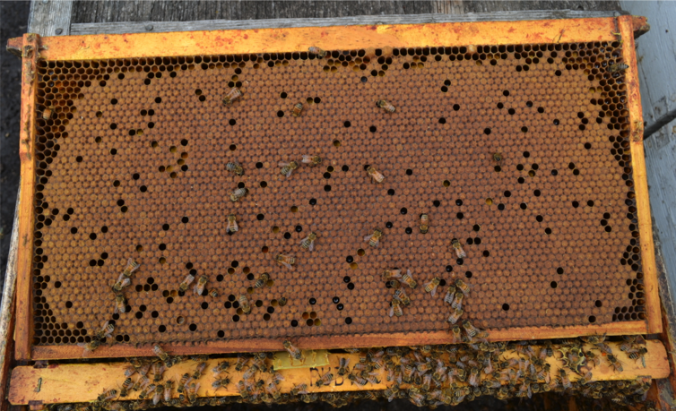
Bad Queens
Spotty Brood
Drone Laying
Low Brood

Slide 10
Stress
Migration
Shipping Packages
UnHealthy Queen
Pests/Diseases
Pesticides
Lost Forage
Proper Nutrition

Slide 11
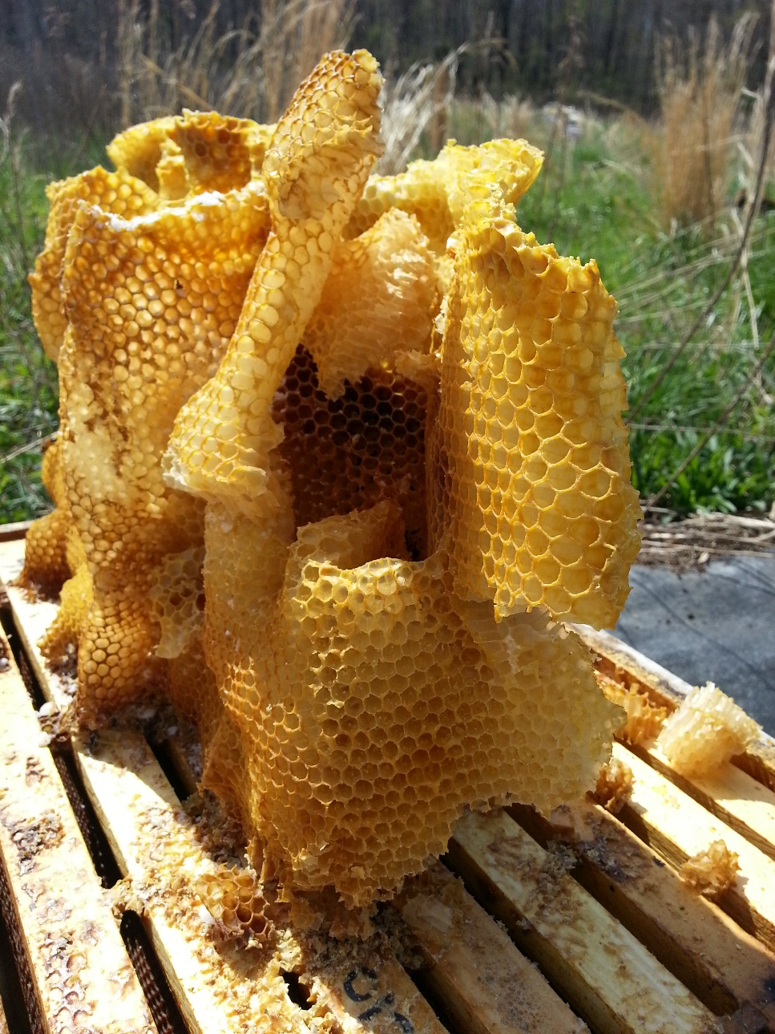
Beekeeper Habits
Chilled Brood
Taking Off Too Much Honey
Deadouts
Hive Management
Migration
Keeping a Bad Queen

Slide 12
Pesticides
Identification
  dead bees in front of the hive
Off Label Application
Dry vs Liquid
Timing

Slide 13
Maintaining a Healthy Hive
Visual Observation
Monitoring
Healthy Queen
Sufficient/Proper Food
  Protein
  Different Colored Pollen

Slide 14
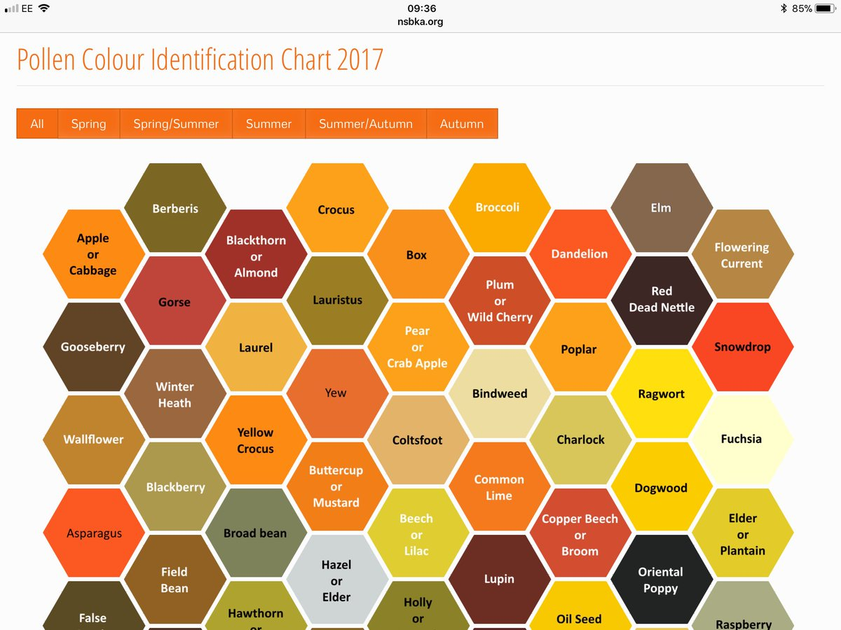

Slide 15
Questions?

