Slide 1
Know Your Bees
The Beekeepers of Indiana
May 13, 2018

Slide 2
Know Your Bees
Wasp Family
  Paper Wasps
  Hornets
  Yellow Jackets
  Mud Daubers
Mason Bees
Carpenter Bees
Bumble Bees
Honey Bees
Notes:
4,000 types of bee are found in American

Slide 3
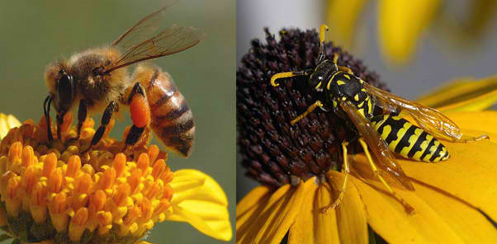
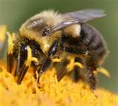
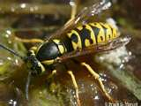
Which One is the Honey Bee?
A
B
Honey Bee
Yellow Jacket
C
D
Bumble Bee
Hornet
The Answer is: A

Slide 4
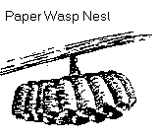
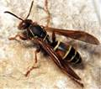
Paper Wasps
Build Umbrella Like Nests
Mostly Around Doors and in Boxes
Less Aggressive Than Hornets and Yellow Jackets
Sting Multiple Times
Eliminate with Spray
  Sunset or very early in the morning
  Do not stand directly under the nest
  After 24 hours, knock down the nest
  Scrape and bleach the stem start
¾” Long
Die During the Winter

Slide 5
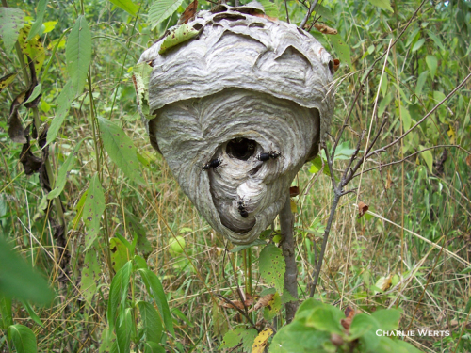
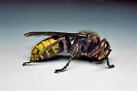

Hornets
Build Tear Drop Shaped Enclosed Nests
Single Opening Usually on Bottom
Mostly on Limbs and Bushes
Extremely Aggressive
Sting Multiple Times
Eliminate with Spray
  Treat Wearing Full Suit
  Sunset, Cover with bag
  After 24 hours, remove the nest
2” Long
Die During the Winter

Slide 6
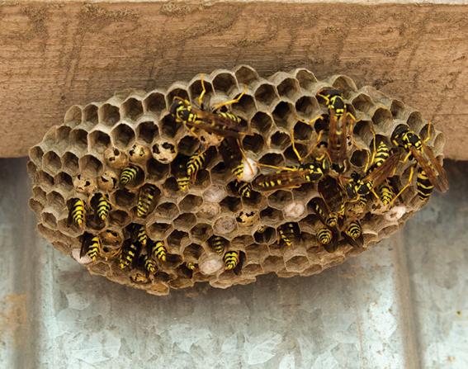
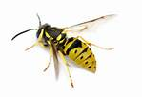

Yellow Jackets
Mostly Nest in the Ground
Often Mistaken for Honey Bees
Extremely Aggressive
Sting Multiple Times
Eliminate with Spray or Hot Water
  Late at Night
  Dig up nest and destroy
½” Long
Die During the Winter

Slide 7

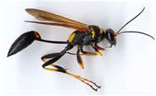

Mud Daubers
Nest on Side of Buildings
Tube-like Cells
Less Aggressive
Rarely Sting
Eliminate with Spray
  Smash the tubes
  Remove tubes
½” to 1” Long
Die During the Winter

Slide 8
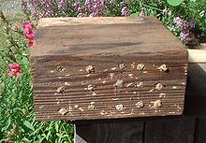
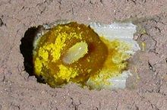
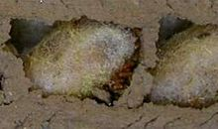
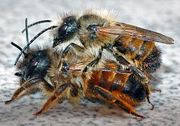
Mason Bees
In Wood, Twigs,
Native to American
Great Pollinators
Do Not Make Honey or Beeswax
Every Female Has Own Nest
Males Emerge First Each Spring
Elimination Not Required
1/4” to 3/8” Long
Stay In Cocoon Until Spring
Revisit Old Nests

Slide 9
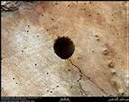
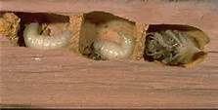

Carpenter Bees
In Wood, Drill Near Perfect Round Hole
Nest is Much Larger,
Shiny Black Adomen
Rarely Sting, Male Has No Stinger
Size Is Scary
Elimination Requires Treating the Nest
  Use a long residual dust
  Long nozzle sprayer
1” Long
Hibernate During the Winter
Revisit Old Nests

Slide 10
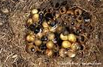
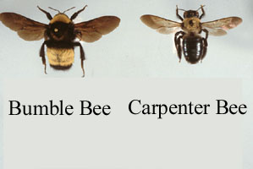
Bumble Bees
Usually on the Ground
Under a Tarp or Deck
Late Summer Queens Find Loose Bark
Avoid Human Contact
Less Aggressive
Can Sting Multiple Times
Elimination
  Clean up area, or
  Pest Control Professionals; Cypermethrin
¾” to 1 ½” Long
Die During the Winter

Slide 11
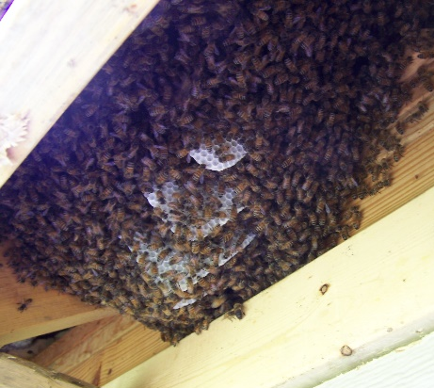
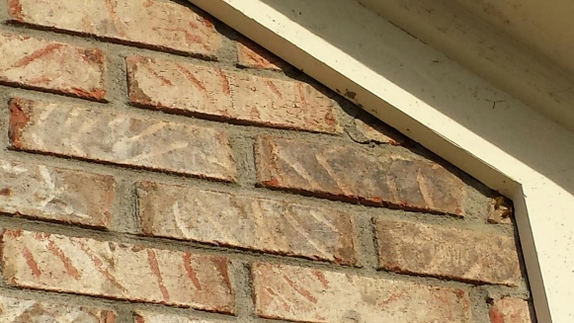
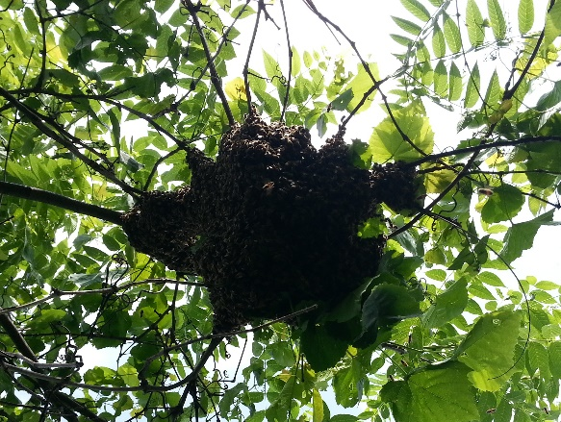

Honey Bees
Inside Trees and Structure
Wax Comb
Less Aggressive
Can Only Sting Once
Aggravated by Vibration, Loud Noises, Smell
Scrape the Stinger
Call a Beekeeper
½” to ¾” Long
Do Not Die During the Winter
Hive May Have 10 to 50k

Slide 12
Does and Don’ts
Hit It With a Stick
Shoot It With a Gun
Wave Your Hands
Attempt to Eliminate Yourself
Do Not Use Lawn Mower Until Bees are Neutralized
Do Not Cut Down the Tree Until Bees are Neutralized
Honey Bee Stings
  Pull a stinger out with your nails
  Scrape the stinger out

Slide 13
If You Get Stung
Use a Cold Compress Where Stung
  remove the stinger first then apply a chopped white onion to the area. The anti-inflammatory properties of the onion will reduce the swelling and draw out the poison to speed up the healing process.
Take an Antihistamine
3% Have an Allergic Reaction
  Redness
  Painfull
  Swelling
  Itching
0.8% Life-threatening Allergic
  Hives
  Difficulty breathing or swallowing
  Wheezing or similar symptoms
Notes:
Itching, pain and localized swelling can be somewhat reduced with antihistamines and a cold compress.

Slide 14
Additional Information
Mike and Debbie Seib
  317-432-4352 Mike’s Cell
  317-432-9578 Debbie’s Cell
  mike@seibshoosierhoney.com
Kathleen Prough
  317-412-3315 Cell
  kprough@dnr.IN.gov

